Slide 1
Fundamentals of Machine Learning Week 7: Unsupervised learning
Jonas Moons
All images are either own work, public domain, CC-licensed or fair use
Credits on last slide

Slide 2



Check-in

Slide 3
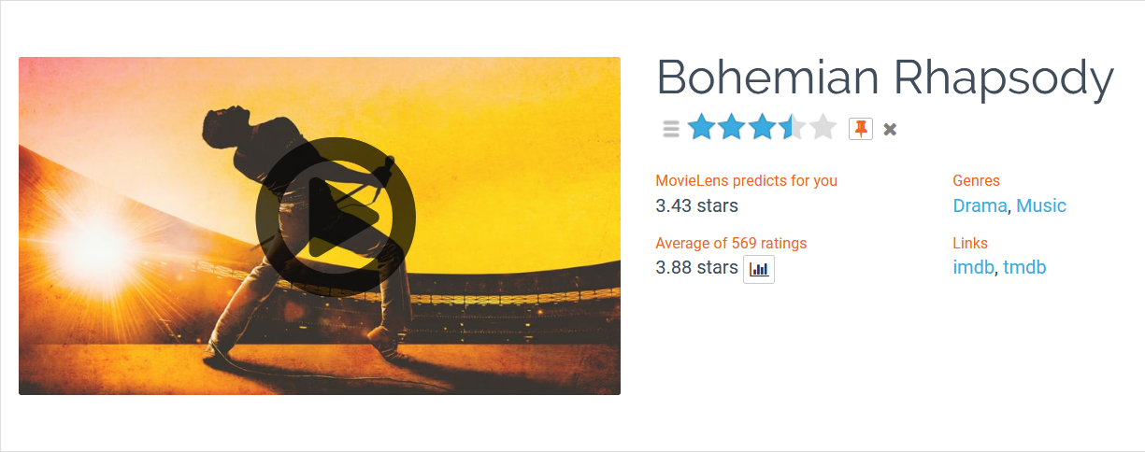
Intro

Slide 4
This week
How to use information from users…
To generate user or item ‘profiles’ with clustering (this lesson)
To make recommendations to users (next lesson)

Slide 5
Topics
MovieLens data set
Clustering
k-means clustering

Slide 6
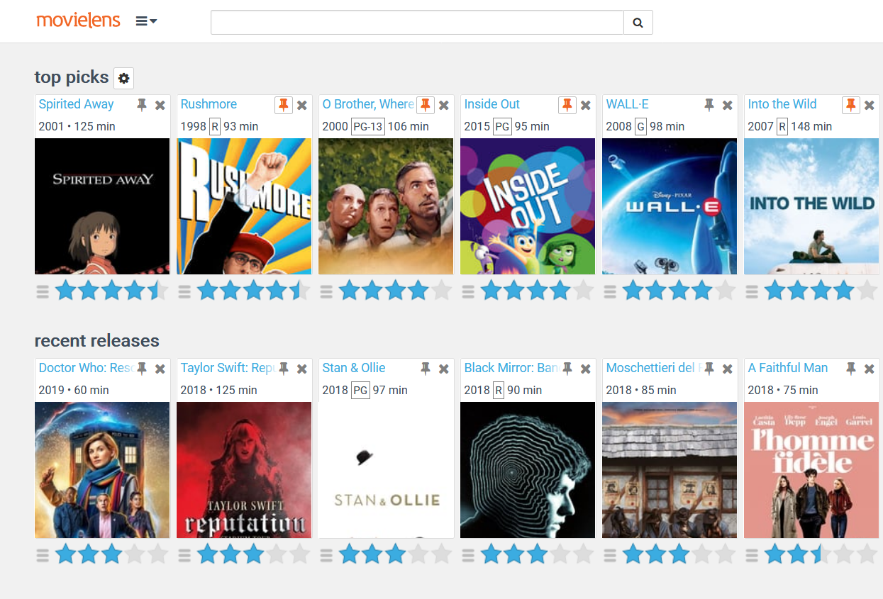

Slide 7
MovieLens data set
Project for movie recommendations and academic research from University of Minnesota (grouplens.org)
Full dataset: 20 million ratings and 465,000 tag applications to 27,000 movies by 138,000 users.
For a better overview, we will work with the smaller dataset with 100,000 ratings to 9,000 movies by 600 users

Slide 8
User-item matrix
 | Pulp Fiction | Toy Story | The Dark Knight | La La Land | Star Wars
User 1 | 4 | - | - | - | 4
User 2 | 3 | 2 | 5 | - | 3
User 3 | 5 | 4 | - | - | 4
User 4 | - | - | 5 | 4 | -
User 5 | 4 | 4 | - | 3 | -

Slide 9
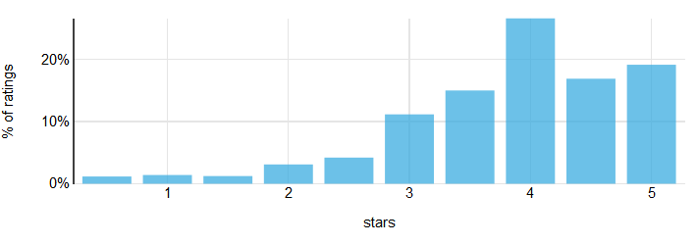
User ratings
Ratings are typically left-skewed and the mean is above the center of the scale
Ratings (especially product ratings) may have a smaller peak at the low end
People vote for their favorites

Slide 10
Exercise 1: data wrangling
In this Exercise you are going to prepare the MovieLens dataset for use this week. See the pivot_table Notebook in the Examples folder and the cookbook for reference to material from earlier weeks. See clustering/exercise folder for the data set.
Load the files ratings.csv and movies.csv in a Notebook and merge them (remember which function to use?).
Look at the pivot_table Notebook in the Examples folder. How might you use a pivot table to make a user-item matrix? Remember: a user-item matrix is a table of the ratings, with users in the rows and items in the columns. What are the items?
Using head(), check if your matrix is correct.
Plot a histogram of all the ratings of a movie of your choice.

Slide 11
Topics
User ratings
Clustering
k-means clustering

Slide 12
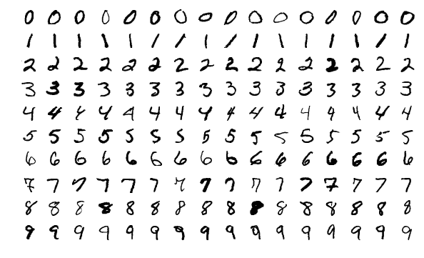
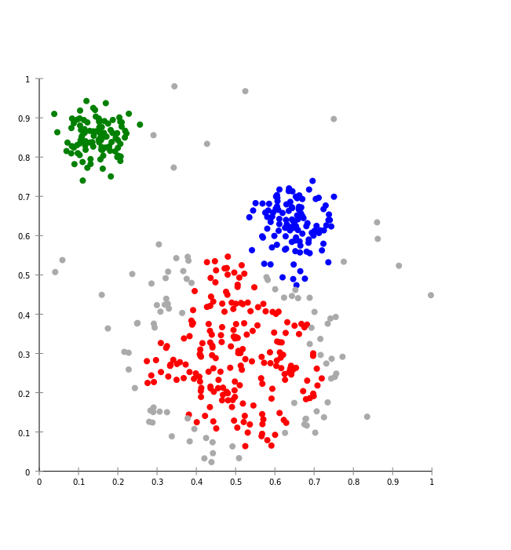

Supervised vs. unsupervised learning
Supervised: use known patterns to predict new cases
Handwriting recognition
Unsupervised: you let the algorithm discover patterns/clusters on its own
Spotify Radio / Discover Weekly
MNIST data set

Slide 13
Why clustering?
To discover interesting and useful clusters in the data and adapt our content or marketing strategy
For instance, different user types based on behavior (user profiling), e.g.
Explicit: likes, favorites, ratings, comments, etc.
Implicit: pages visited, content seen, mouse movements, etc.

Slide 14
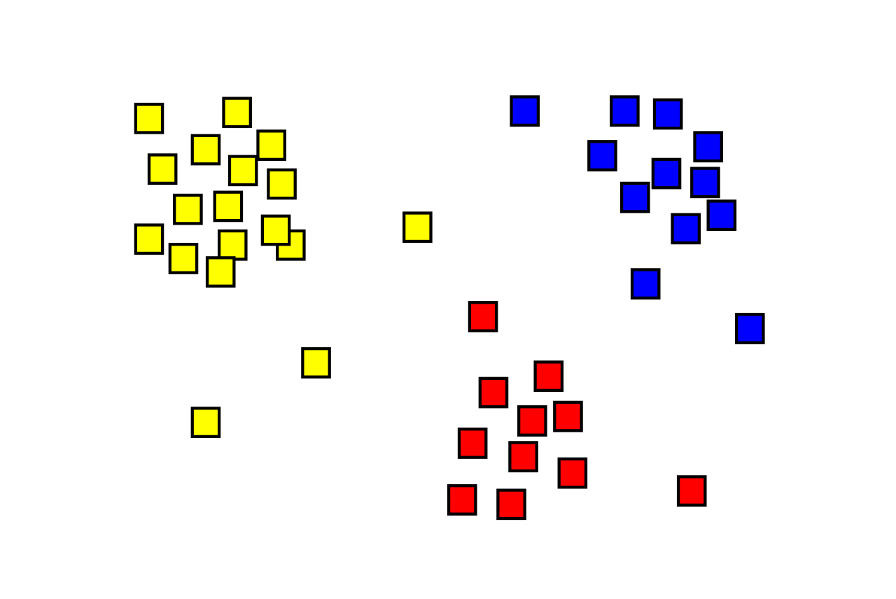
What is clustering?
Assign observations to several clusters
It’s not always clear which solution is ‘correct’
There are many algorithms; we will use k-means (simple to understand but often suboptimal)
Remember: shown as 2-dimensional here but n-dimensional in reality, n being the number of variables used

Slide 15
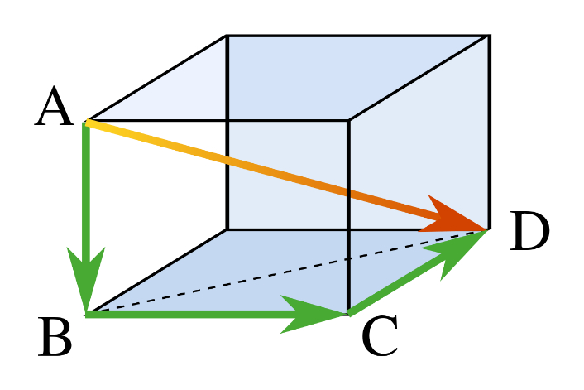
Distance
Each user is represented by a point in space
Each item (movie) is a dimension
The distance between two users can be calculated for any number of dimensions/movies (shown: 3)
User | Movie 1 | Movie 2 | Movie 3
1 | 5 | 3 | 5
2 | 4 | 1 | 2

Slide 16
Topics
MovieLens data set
Clustering
k-means clustering

Slide 17
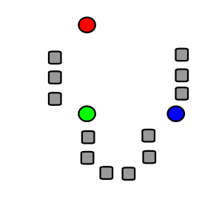
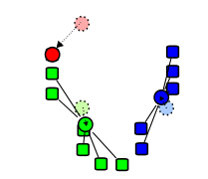
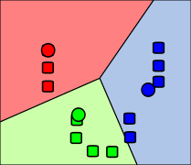
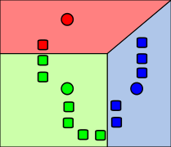
k-means algorithm
1. Start with k cluster centers at random
2. Assign each observation to nearest center
3. Move cluster centers to center of observations
4. Repeat until stable

Slide 18
K-means clustering

Slide 19
Exercise 2: clustering Iris data set
In this exercise, you will explore the logic of clustering using the famous Iris data set. See the Exercise folder for the data set (iris.csv), and the Notebook k-means in the Examples folder.
Read in the csv file.
Using a Seaborn scatterplot, plot the Iris data set with petal length on the x-axis and sepal length on the y-axis. Plot the different Iris species with a different symbol (see the Seaborn documentation).
What possible clusters do you see with the naked eye? How do they relate to the three species?
Using k-means clustering with 3 clusters (using only petal length and sepal length as X variables), create a new variable cluster and use this to make another scatterplot, using color for cluster.
How does k-means perform?
Try out different numbers of clusters to see what happens. What seems like the ‘natural’ number of clusters for this data set?

Slide 20
Problems with k-means
k-means can only make Voronoi cells (straight lines)
Suitable number of clusters often hard to determine in practice

Slide 21
Exercise 3
For exercise 3, some pre-processing has been done:
Filling the NaN of unrated movies with 0 (not at all a great solution -> why not?)
Ordering the columns of the dataframe from most frequently rated to least frequently rated
Your job is to finish the example code

Slide 22
Exercise 3: clustering users
In this Exercise, you will use the Movielens data to find user clusters with similar taste. The first part has been done, see movielens_clustering in the Examples folder.
What would be a suitable number of clusters to divide moviegoers into?
Apply the k-means algorithm to the Movielens user-item matrix that is in the code. Store the cluster predictions in the original ratings dataframe and continue working with that dataframe (why?).
How many users are there per cluster (which Pandas function do you need?)?
Calculate the mean rating by user cluster using the Pandas pivot_table function. Pandas will sort alphabetically, so you will need to reorder your pivot table with my_pivot.reindex(ratings.count().sort_values(ascending=False).index, axis=1)
Examine the mean ratings of the top rated movies by user cluster. Can you describe the user clusters in plain language (e.g., ‘simple-minded action movie lover’)? This may be hard…

Slide 23
Image credit
Pythagoras by CheCheDaWaff (CC-BY-SA)
K-means algorithm pictures by Weston.pace (CC-BY-SA)
K-means gif by Chire (CC-BY-SA)

